Slide 1

Netflix - Movie Recommendation
Michael Halim / C14190119
Bryan Fernando Liauwan / C14190020
Dick Jovian / C14190076

Slide 2

Table of Contents
First Part .
The cinema industry is no longer relevant ?
Third Part .
How to respond to that situation ?
Second Part .
What do the facts say?
Last Part .
Recommendation

Slide 3

First Part:
The cinema industry is no longer relevant?
Source: The Jakarta Post

Slide 4


“ I’m having difficulty picking a movie as there are so many choices. ”
“I 'd like my movie tastes to be well-understood.”
“ I'd like to be recommended a movie that I'm likely to enjoy. ”
“ I'm curious as to what films are similar to the one I just saw. ”
Source: Freepik

Slide 5
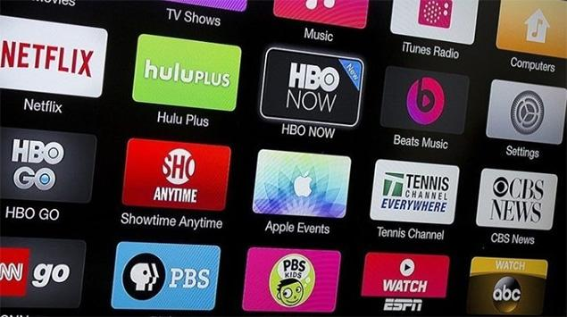


Consequences of Failing Satisfy Desires
Competitors Will Take Priority
Consumers Will Leave
Big Loss Will Happen
Source: Jurnal Apps
Source: iStock
Source: Deposit Photos

Slide 6



But, The Other Way Around
According to McKinsey, 35% of Amazon purchases are thanks to recommendations systems.
Source: Wikipedia
30% of the overall views on YouTube come from relevant recommendations.
Source: Kumparan
Every week, Spotify generates a new customized playlist for each subscriber called Discover Weekly.
Source: Sportify

Slide 7

Second Part:
What do the facts say?
Source: Scholars Official

Slide 8
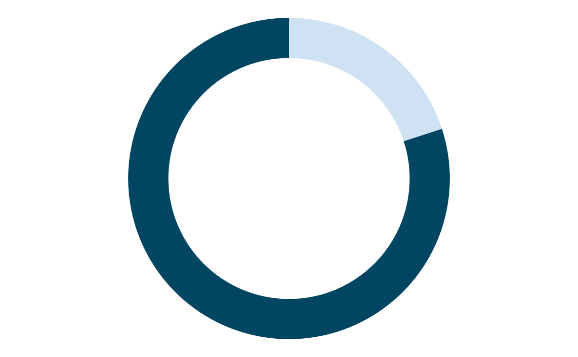
Netflix’s Recommender System
how important?
savings on customer acquisition
$ 1B
80%
of stream time is achieved through Netflix’s recommender system.
estimated per year as of 2016.

Slide 9
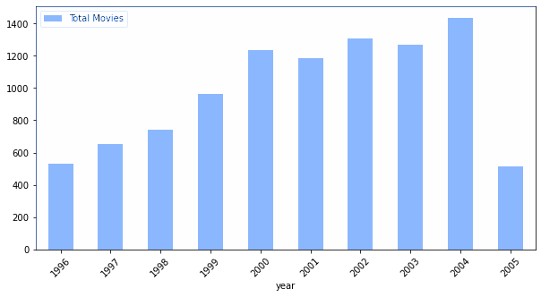
View Data Facts (1)
Number of Movies from 1996 - 2005

Slide 10
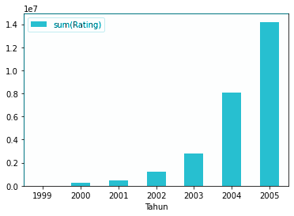
View Data Facts (2)
User Growth by First Time Rating
According to David Chong, Towards Data Science, Apr 30, 2020:
Netflix introduced personalised movie recommendations.
The total user interaction as seen from the rating in 2005 was:
>14,2 million

Slide 11

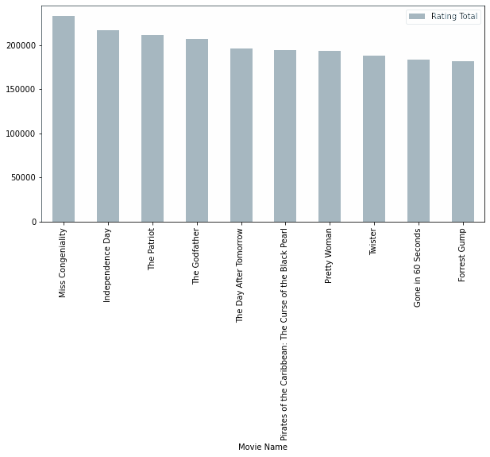
View Data Facts (3)
The Top 10 Most Ratings Movies
Source: YouTube
Miss Congeniality - 2000
This movie is the movie with the highest total interaction rating, which is more than 20 thousand.

Slide 12

View Data Facts (4)
The Top 10 Most Ratings Movies
Source: Facebook
Independence Day - 1996
This movie is the movie with the second highest rating. The film also managed to surpass 20 thousand ratings.

Slide 13





View Data Facts (5)
Top 5 Movie by Average Ratings
Source: Binged
Source: Amazon
The Lord of the Rings: The Fellowship of the Ring: Extended Edition
Lord of the Rings: The Two Towers: Extended Edition
4.71/5
4.70/5
Source: Tribun Style
Lord of the Rings: The Return of the King: Extended Edition
4.72/5
Source: Hotstar
Source: Rotten Tomatoes
Lost: Season 1
Battlestar Galactica: Season 1
4.67/5
4.63/5

Slide 14
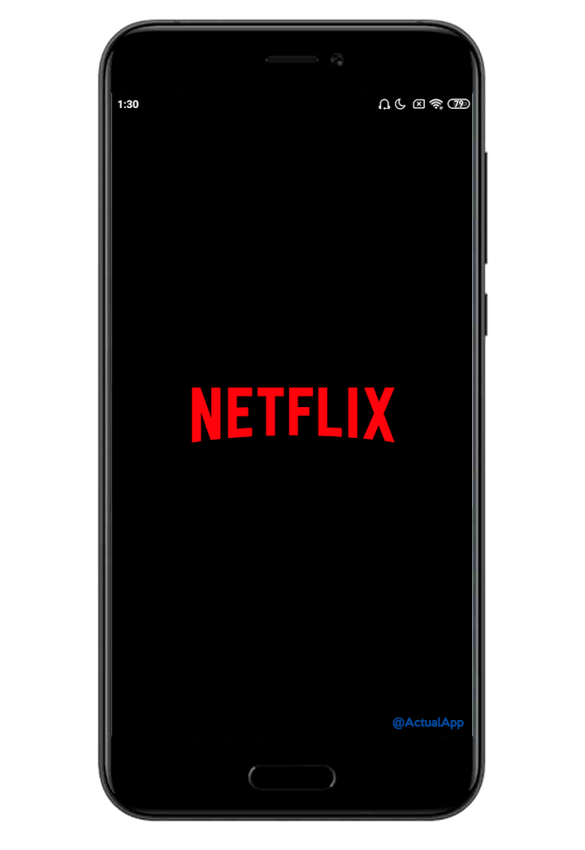
Third Part:
How to respond to that situation?
Source: apsachieveonline

Slide 15
Recommendation System
Recommendation Machine
Alternating Least Squares (ALS)
Needs
Process
Result
Data items, their attributes, and user interactions will be processed by the machine.
The machine will learn the existing data (a.k.a training data), then the machine will produce output in the form of predictions.
Predicts rating of items. The higher the rating of a certain item, the more that item will be recommended.

Slide 16
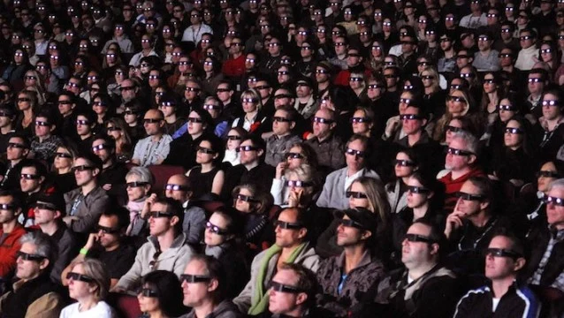
Recommendation System
Alternating Least Squares: Process
Data processed by machine (ALS)
Taken 200 samples from millions of data
The machine will issue 1 recommended top movie to each user
Source: We Got This Covered

Slide 17
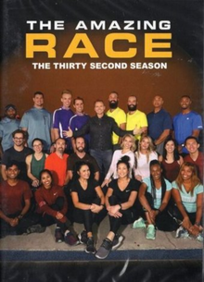

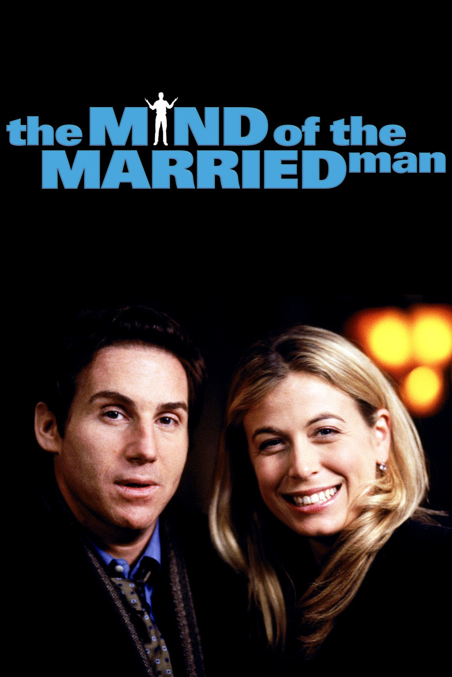
Recommendation System
The Top 3 Most Recommended Movie by ALS
Source: Wikipedia
Source:The Backyardigans Wiki - Fandom
Source: Rotten Tomatoes
The Amazing Race: Season 1
Backyardigans: It's Great to Be a Ghost
The Mind of the Married Man: Season 1
74/200
22/200
16/200

Slide 18


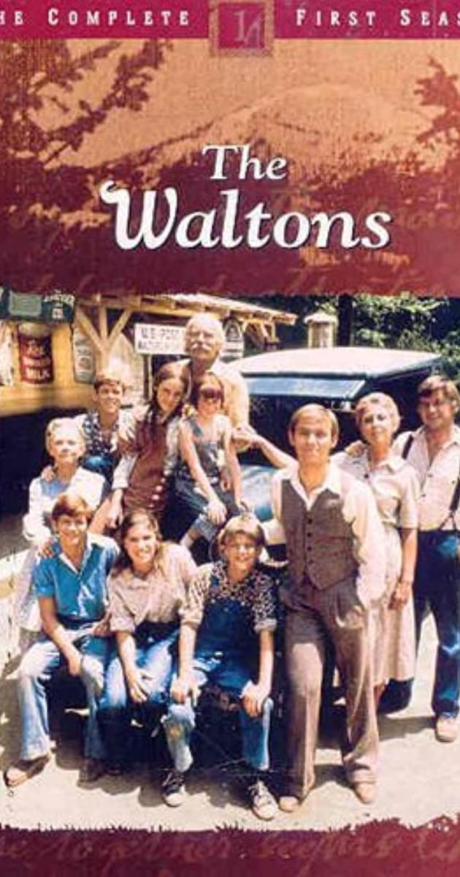
Recommendation System
The 3 Least Recommended Movies by ALS
Source: Wikipedia
Source: Wikipedia
Source: IMDb
The Waltons: Season 2
The Man Who Copied
Rana's Wedding
1/200
1/200
1/200

Slide 19
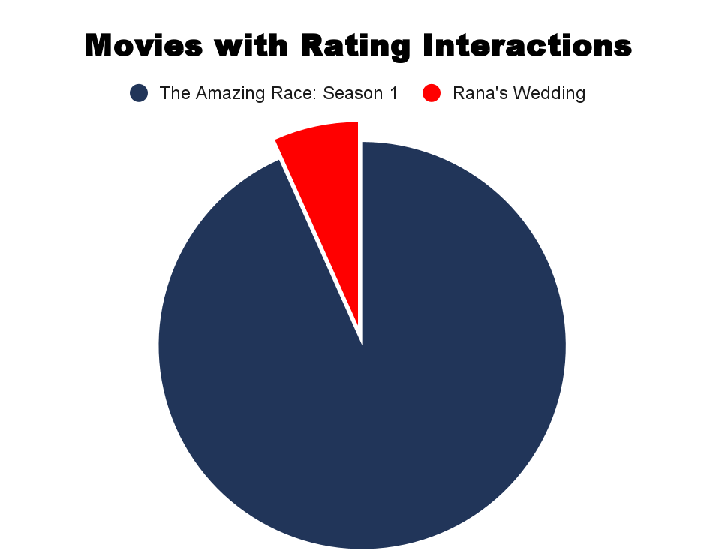
Recommendation System
Compare the Two Movies
Source: Wikipedia
Source: Wikipedia
The Amazing Race: Season 1
Rana's Wedding
74/200
1/200

Slide 20

Recommendation System
Large Error Range of the System
Example:
2.1 3 3.9
prediction
RMSE : 0.9421247199
Source: DigitBin

Slide 21

Last Part:
Recommendation
Source: Depositphotos

Slide 22
Recommendation (1)
1
Use system recommendations in the digital film industry to make customers feel closer to what they want.
2
Maximize the data for the following years to the future in order to follow market behavior.
3
Develop a recommendation system to be closer to the tastes of each user.

Slide 23
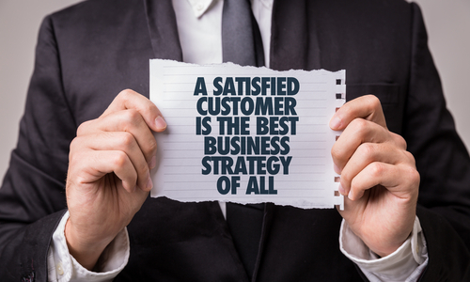
Recommendation (2)
Source: Cashlez

Slide 24
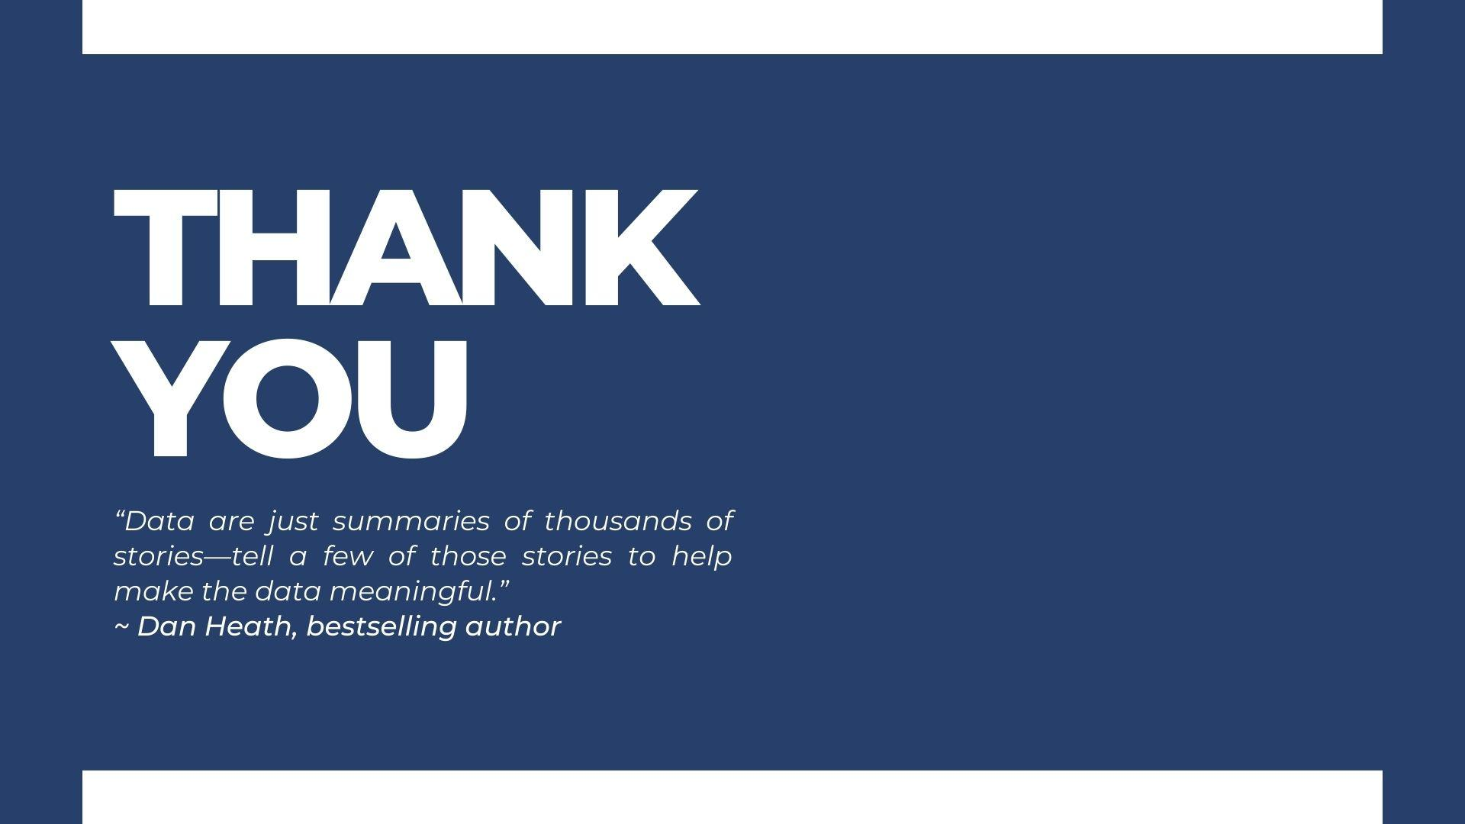
References:
https://recostream.com/blog/recommendation-system-netflix#:~:text=In%202000%2C%20the%20company%20introduced,main%20prize%20was%20%24%201%20million
https://towardsdatascience.com/deep-dive-into-netflixs-recommender-system-341806ae3b48
https://research.aimultiple.com/recommendation-system/

Slide 25
Sources:
https://img.jakpost.net/c/2020/01/13/2020_01_13_84657_1578902715._large.jpg
https://www.freepik.com/premium-vector/moviegoer-3d-glasses-watching-movie-cinema-flat-vector-illustration_26308232.htm
https://apsachieveonline.org/in/cara-memperbaiki-netflix-kesalahan-perangkat-di-aplikasi-anda/
https://jurnalapps.co.id/perbandingan-netflix-disney-holostar-amazon-prime-dan-hbo-go-110298
https://www.istockphoto.com/photos/missing-people
https://id.m.wikipedia.org/wiki/Berkas:Amazon_logo.svg
https://kumparan.com/berita-update/daftar-harga-paket-netflix-terbaru-1vGuiKdBJJS
https://www.youtube.com/watch?v=LwrEnPYHsyQ
https://www.binged.com/streaming-premiere-dates/lord-of-the-rings-return-of-the-king-extended-edition-movie-streaming-online-watch/
https://style.tribunnews.com/2022/06/10/sinopsis-film-the-lord-of-the-rings-the-fellowship-of-the-ring-di-bioskop-trans-tv-malam-ini
https://www.amazon.com/Lord-Rings-Two-Towers-Extended/dp/B005529EI2
https://www.hotstar.com/id/tv/lost/1260032868
https://www.rottentomatoes.com/tv/battlestar-galactica/s01
https://www.scholarsofficial.com/persiapan-beasiswa/fakta-unik-dan-menarik-beasiswa-bias-future-leader/attachment/wood-letters-of-facts-word-on-wood-background/
https://id.depositphotos.com/stock-photos/recommendation.html
https://m.facebook.com/story.php?story_fbid=263904297308556&substory_index=0&id=261297200902599
https://en.wikipedia.org/wiki/The_Amazing_Race_32
https://www.rottentomatoes.com/tv/the_mind_of_the_married_man
https://www.rottentomatoes.com/m/duck_soup
https://wegotthiscovered.com/movies/ten-worst-behaviors-modern-moviegoers/
https://www.primevideo.com/detail/0FFNU0AYHXVII2FUUFFXA7D535/ref=atv_nb_lcl_id_ID?language=id_ID&ie=UTF8
https://www.amazon.com/Little-Prairie-Season-Deluxe-Remastered/dp/B00T94R16O
https://www.imdb.com/title/tt0791098/
https://backyardigans.fandom.com/wiki/It%27s_Great_to_Be_a_Ghost!_%28DVD%29
https://www.cashlez.com/blog/customer-service-vs-customer-success-apa-bedanya_693.html

